Slide 1

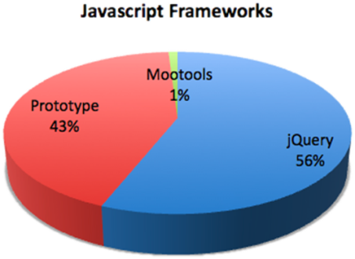

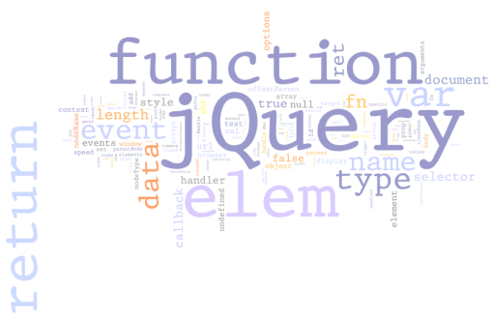

jQuery
http://schoolacademy.telerik.com
Fundamentals, DOM, Events, AJAX, UI
Doncho Minkov
Telerik Corporation
www.telerik.com

Slide 2

Table of Contents
jQuery Fundamentals
Selection and DOM Manipulation
Events and Chaining
AJAX
jQuery AJAX Methods
Executing AJAX Requests
jQuery UI
jQuery Widgets
Implementing Drag and Drop

Slide 3
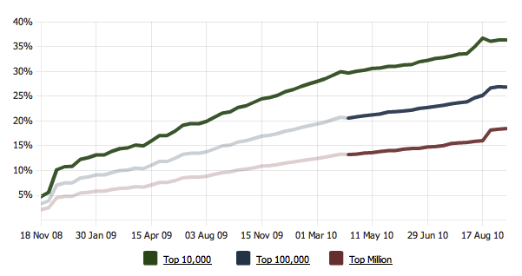
What is jQuery?
The world’s most popular JavaScript library

Slide 4
What is jQuery?
jQuery is a cross-browser JavaScript library
Designed to simplify the client-side scripting of HTML
The most popular JavaScript library in use today
Free, open source software
jQuery's syntax is designed to make it easier to
Navigate a document and select DOM elements
Create animations
Handle events
Develop AJAX applications

Slide 5
What is jQuery? (2)
jQuery also provides capabilities for developers to create plugins for
Low-level interaction and animation
Advanced effects and high-level, theme-able widgets
Creation of powerful and dynamic web pages
Microsoft adopted jQuery within Visual Studio
Uses in Microsoft's ASP.NET AJAX Framework and ASP.NET MVC Framework

Slide 6
Why jQuery is So Popular?
Easy to learn
Fluent programming style
Easy to extend
You create new jQuery plugins by creating new JavaScript functions
Powerful DOM Selection
Powered by CSS 3.0
Lightweight
Community Support
Large community of developers and geeks

Slide 7
How to Add jQuery to a Web Site?
Download jQuery files from
http://www.jquery.com
Self hosted
You can choose to self host the .js file
E.g. jquery-1.5.js or jquery-1.5.min.js
Use it from CDN (content delivery network)
Microsoft, jQuery, Google CDNs
e.g. http://code.jquery.com/jquery-1.5.min.js,
http://ajax.microsoft.com/ajax/jquery/jquery-1.5.min.js
Notes:
Talking Points:
You can choose to self host files - this is including jQuery in the scripts folder in Visual Studio.
Can also just include jQuery from a CDN - simply change the script reference to point to jQuery on the CDN
Can be faster loading and client browser may already have jQuery file cached
Be careful! If the CDN goes down your site may also go down.
Source version is human readable.
Always include the minified version for your production code.

Slide 8
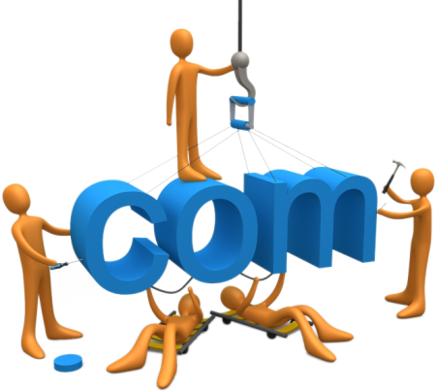

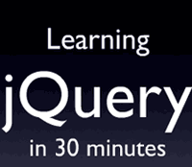

Fundamentals of jQuery
Selecting, Adding, Removing DOM Elements

Slide 9
Selecting and Doing Something
With jQuery you typically find something, then do something with it
Syntax for finding items is the same as the syntax used in CSS to apply styles
There are lots of different jQuery methods to do with the selected elements
// Finding the item
$("#something").hide();
// Doing something with the found item
<div id="something"></div>

Slide 10
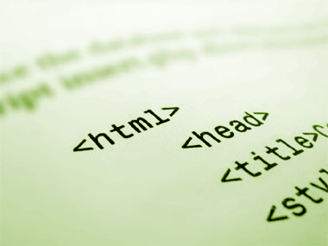
Show Hide Elements
Live Demo

Slide 11
jQuery Fundamentals
When selecting with jQuery you can end up with more than one element
Any action taken will typically affect all the elements you have selected
<div class="myClass foo bar"></div> <div class="baz myClass"></div> <div class="bar"></div>
//...
$('.myClass').hide(); // will hide both elements
//...

Slide 12
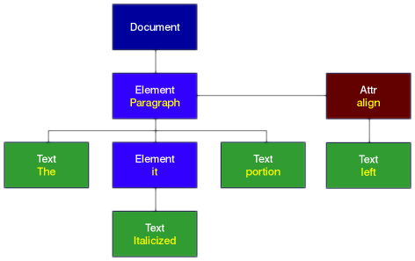

DOM Manipulation
With jQuery HTML adding elements can be done on the fly
Very easily
Can be appended to the page
Or to another element
Still selecting something (brand new), then doing something
$('<ul><li>Hello</li></ul>').appendTo('body');

Slide 13
Removing Elements
You can also remove elements from the DOM
Just as easy
// Before
<div>
<p>Red</p>
<p>Green</p>
</div>
// Removing elements
$('p').remove();
// After
<div>
</div>

Slide 14
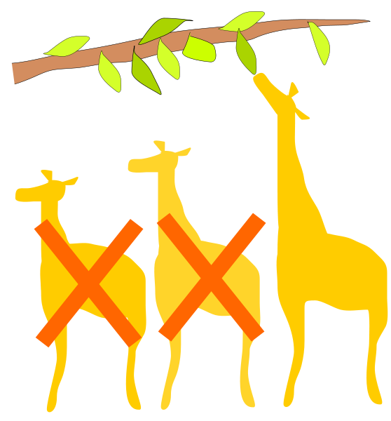
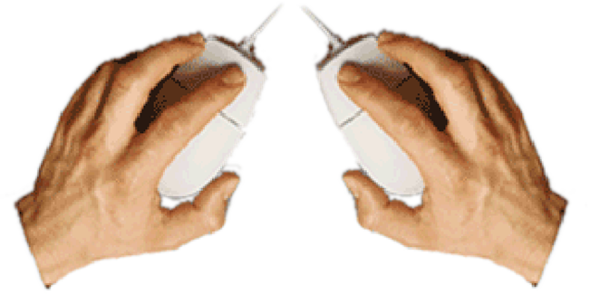
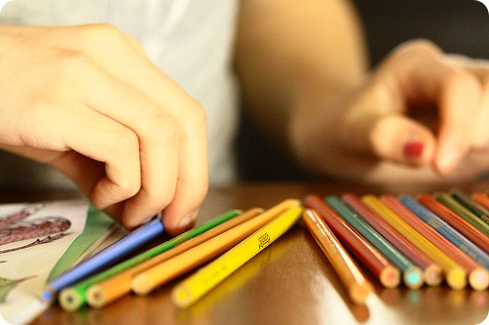
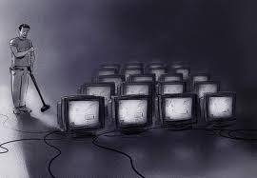
Selecting Multiple Elements
Live Demo

Slide 15
jQuery Events
With jQuery binding to events is very easy
We can specify a click handler
For example by using the click method
The above code will bind the myClickHandler function to all anchors with a class of tab
// Binding an event
function() myClickHandler {
// event handling code
$(this).css('color', 'red');
};
$('a.tab').click(myClickHandler);

Slide 16
jQuery Events
Functions in JavaScript could be anonymous
This is the same exact functionality as the previous example
This is important because in the previous example we polluted the global scope with a new function name
Can be dangerous as someone could overwrite your function with their own accidentally
$('a.tab').click(function() {
// event handling code
$(this).css('color', 'red');
});

Slide 17
jQuery Method Chaining
With jQuery many methods allow chaining
Chaining is where you can continue to "chain" on methods one after another
As an example, the addClass method will add the class 'odd' in the code below
Then return the jQuery collection
We can immediately chain on the "click" event
Click then operates on the odd rows by adding a click handler to each of them
$('tr:odd').addClass('odd')
.click(function () { alert('you clicked a tr!'); });

Slide 18
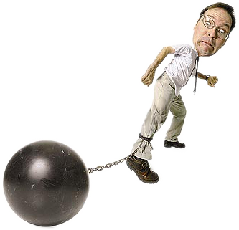
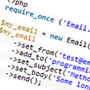
Chaining Methods
Live Demo

Slide 19

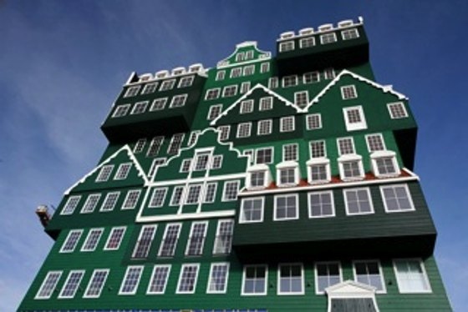

jQuery Stack Architecture
Some jQuery methods chain and return a new collection of elements
'Find' and 'Filter' are two examples
jQuery holds on to the previous collections, essentially creating a stack set to store them

Slide 20
jQuery Stack Architecture (2)
Methods like Find and Filter create a new collection which is added to the stack
Older collections are pushed further 'downward' on the stack
You can get a previous collection back from the stack by using the end() method
$('body') // [body]
.find('p') // [p, p, p] > [body]
.find('a') // [a, a] > [p, p, p] > [body]
.addClass('foo')
.end() // [p, p, p] > [body]
.end() // [body]

Slide 21

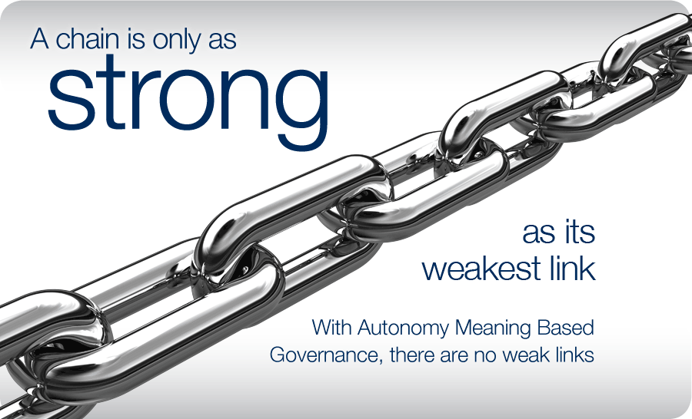
jQuery & Chaining and Architecture
This is a popular use that shows both chaining and the stack architecture
$('tr')
.filter(':odd')
.addClass('myOddClass')
.end()
.filter(':even')
.addClass('myEvenClass');

Slide 22
jQuery & Chaining and Architecture (2)
We first select all rows
Then filter to only the odd rows
The odd rows are placed on the top of the stack
The 'all rows' collection is now 'pushed downward'
Add a class to the odd rows
We call end
Throws away our 'odd rows' collection
Grabs the next element in the stack
The 'all rows' collection
We then filter to find even rows
We add a class to the even rows

Slide 23
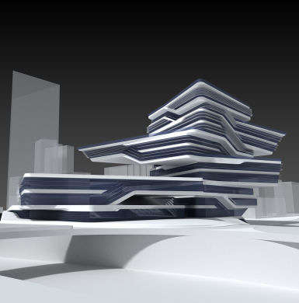

jQuery Stack Architecture
Live Demo

Slide 24



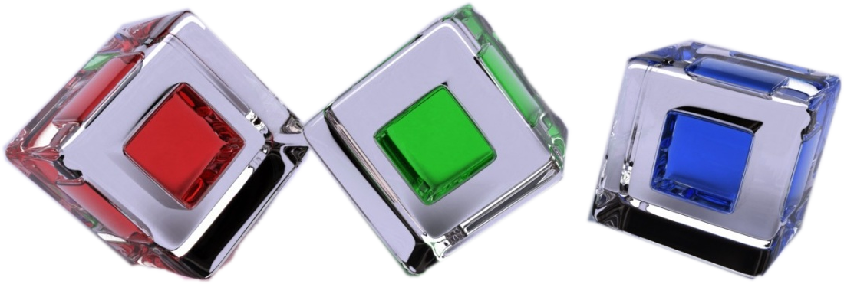
Dynamically Assigning a Class
Live Demo

Slide 25


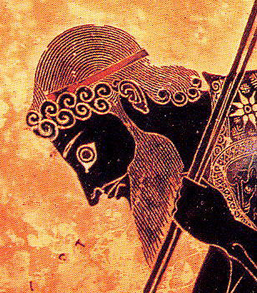

jQuery AJAX

Slide 26
AJAX Fundamentals
AJAX is acronym of Asynchronous JavaScript and XML
Technique for background loading of dynamic content and data from the server side
Allows dynamic client-side changes
Two styles of AJAX
Partial page rendering – loading of HTML fragment and showing it in a <div>
JSON service – loading JSON object and client-side processing it with JavaScript / jQuery

Slide 27
jQuery Ajax
You can use jQuery Ajax to seamlessly integrate with server side functionality
jQuery makes simple the asynchronous server calls
jQuery.ajax(…)
The core method for using AJAX functionality
The shortcut methods use it 'under the hood'
Thus it can do everything
$.get(…) and $.post(…)
Executes a server-side request and returns a result
The HTTP action that will occur is POST or GET

Slide 28
jQuery Ajax (2)
$.getJSON(<url>)
Uses the GET HTTP action and inform the server to send back JSON-serialized data
$(…).load(<url>)
Gets HTML from the server and loads it into whatever you have selected (e.g. a <div>)
Note that jQuery AJAX does not use a selection (except for .load(…) method)
With certain jQuery methods there is not a logical reason to make a selection first
Most AJAX methods fall into that category

Slide 29
jQuery Ajax – $(…).load()
Example of dynamically loaded AJAX content:
$(…).load(<url>)
Gets an HTML fragment from the server and load it into whatever you have selected
Data could come from a PHP script, a static resource or an ASP.NET page
Note that the server should return a page fragment
If it returns a whole HTML page, then we are going to have some invalid HTML!
$('#myContainer').load('home/myHtmlSnippet.html');

Slide 30
jQuery Ajax – Example
<button>Perform AJAX Request</button>
<script type="text/javascript">
$("button").click(function() {
$.ajax({
url: "data.html",
success: function(data){
$('#resultDiv').text(data);
}
});
});
</script>
<div id="resultDiv">Result will be shown here</div>
Note that data.html will not be loaded unless the script comes from a Web server
AJAX URL should reside on the same Web server

Slide 31
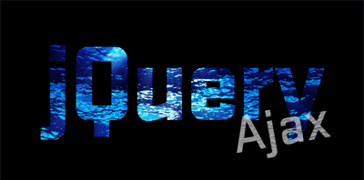
jQuery AJAX: JSON-Style AJAX and Partial Rendering
Live Demo

Slide 32

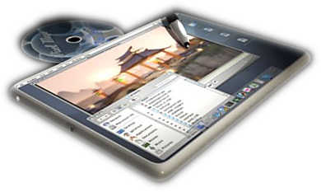
jQuery UI

Slide 33
jQuery UI
jQuery UI is a separate JavaScript library
Lives in a separate .js file
jQuery UI contains three different groups of additions
Effects: draggable, droppable, resizable, selectable, sortable
Interactions: show & hide additions, color animation, easings
Widgets: Accordion, Autocomplete, Button, Datepicker, Dialog, Progressbar, Slider, Tabs

Slide 34
Widgets
jQuery widgets are UI components for the Web
All widgets are theme-able!
Adding most widgets is very simple in code:
$("input:text.date").datepicker();
$("#someDiv").accordion();
var langs = ["C#", "Java", "PHP", "Python", "SQL"];
$("#langBox").autocomplete({ source: langs });
<div id="dialog" title="a title"><p>Some text</p></div>
$("#dialog").dialog();
$("#slider").slider();

Slide 35
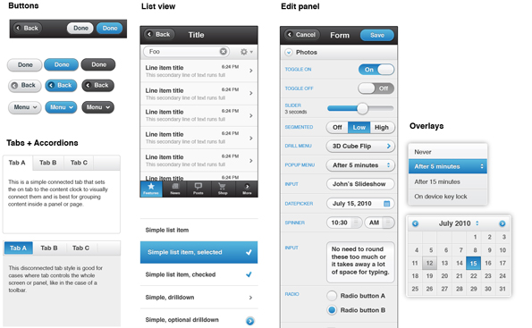
jQuery UI
Live Demo

Slide 36
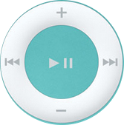

jQuery UI Drag-and-Drop
Live Demo

Slide 37
jQuery Fundamentals
?
?
?
?
?
Questions?
?
?
?
?
?
?
http://schoolacademy.telerik.com

Slide 38
Exercises
Open the file /exercises/index.html in your browser
Select all of the div elements that have a class of "module".
Come up with three selectors that you could use to get the third item in the #myList unordered list
Select the label for the search input using an attribute selector
Count hidden elements on the page (hint: .length)
Count the image elements that have an alt attribute
Select all of the odd table rows in the table body

Slide 39
Exercises (2)
Open the file /exercises/index.html in your browser
Select all of the image elements on the page
Log each image's alt attribute
Select the search input text box, then traverse up to the form and add a class to the form.
Select the list item inside #myList that has a class of "current"
Remove that class from it
Add a class of "current" to the next list item

Slide 40
Exercises (3)
Open the file /exercises/index.html in your browser
Select the select element inside #specials
Traverse your way to the submit button.
Select the first list item in the #slideshow element
Add the class "current" to it, and then add a class of "disabled" to its sibling elements

Slide 41
Exercises (4)
Open the file /exercises/index.html in your browser
Add five new list items to the end of the unordered list #myList
Remove the odd list items
Add another h2 and another paragraph to the last div.module
Add another option to the select element
Give the option the value "Wednesday"
Add a new div.module to the page after the last one
Put a copy of one of the existing images inside of it

